Slide 1
Object Persistence using Hibernate
Collection Mapping and Logging in Hibernate

Slide 2

Collection Mapping in Hibernate
Mapping List in Collection using XML file
Mapping Bag in Collection using XML file
Mapping Set in collection using XML file
Mapping Map in collection using XML file
What's in This Module

Slide 3
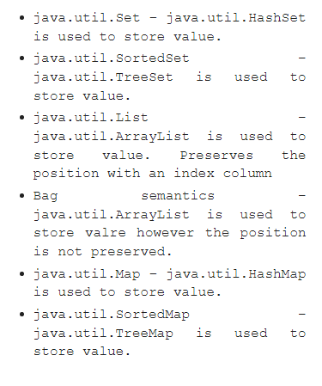
Hibernate Collection Mapping

Slide 4

Assisted Practice
Mapping List in Collection using XML file

Slide 5
Assisted Practice
Mapping Bag in Collection using XML file

Slide 6
Assisted Practice
Mapping Set in Collection using XML file

Slide 7
Assisted Practice
Mapping Map in Collection using XML file

Slide 8
Hibernate Logging

Slide 9
Assisted Practice
Hibernate logging by Log4j using xml file

Slide 10
Assisted Practice
Hibernate logging by Log4j using properties file

